Slide 1

Segmenting Birmingham (UK) for Investments
Ankita Sinha

Slide 2
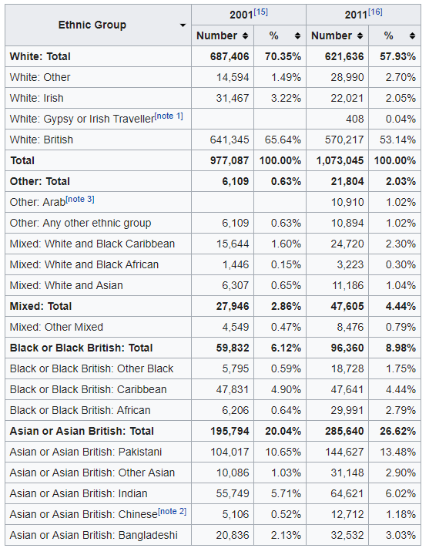
Contents
Business Problem
Data Sources
Methodology
Results
Discussion
Conclusion
Demographics of Birmingham (Wikipedia)

Slide 3
Business Problem
Lack of safe investments in the economy
Property market seen as low risk
With changes in demographics over past ten years, what are safe investments that can be made in Birmingham in the property market?

Slide 4
Data and Methodology
Postcode data: https://www.freemaptools.com/download-uk-postcode-lat-lng.htm
Use longitude and latitude data to make a foursquare API call
Obtain list of venues by postcode
Identify most common venues
Segment Birmingham by likewise areas with machine learning algorithm: clustering

Slide 5
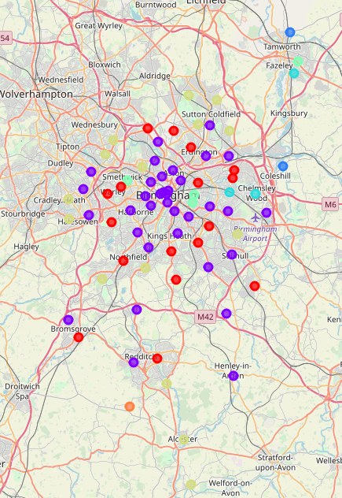
Results
7 clusters: 3 main, 4 outlier
Purple: Urban areas
Red: Suburban
Yellow: Rural
Top three most prevalent venues for each cluster plotted

Slide 6
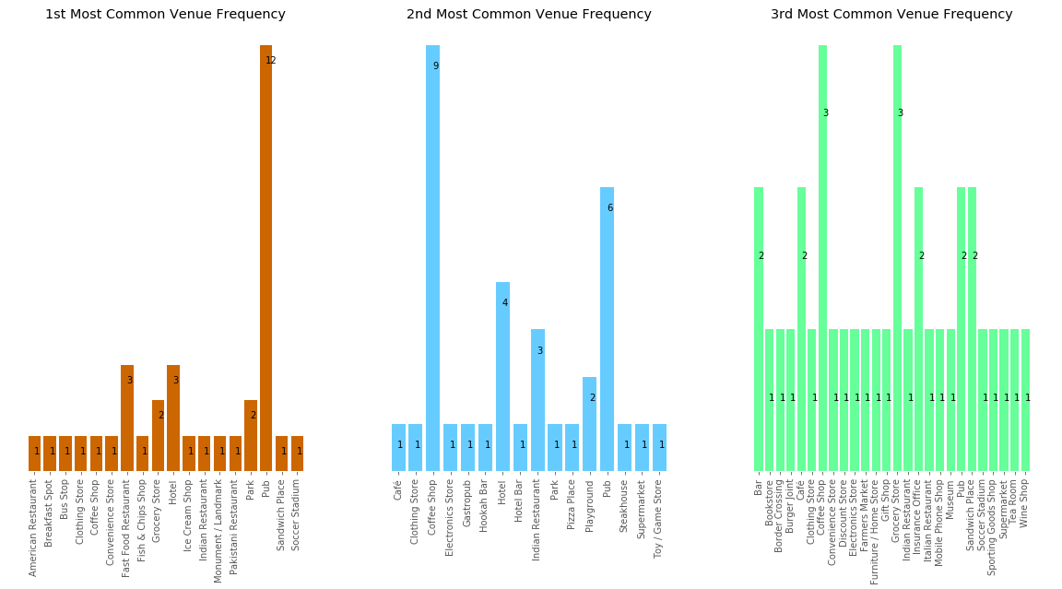
Purple Sector

Slide 7
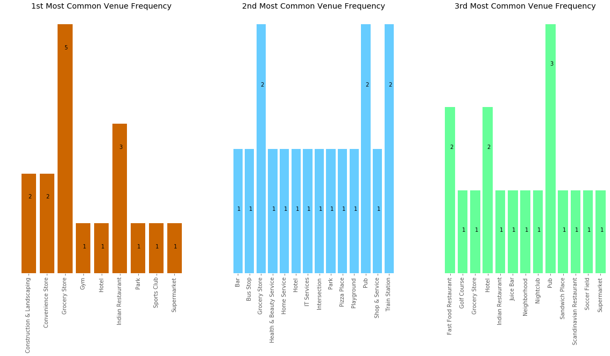
red Sector

Slide 8
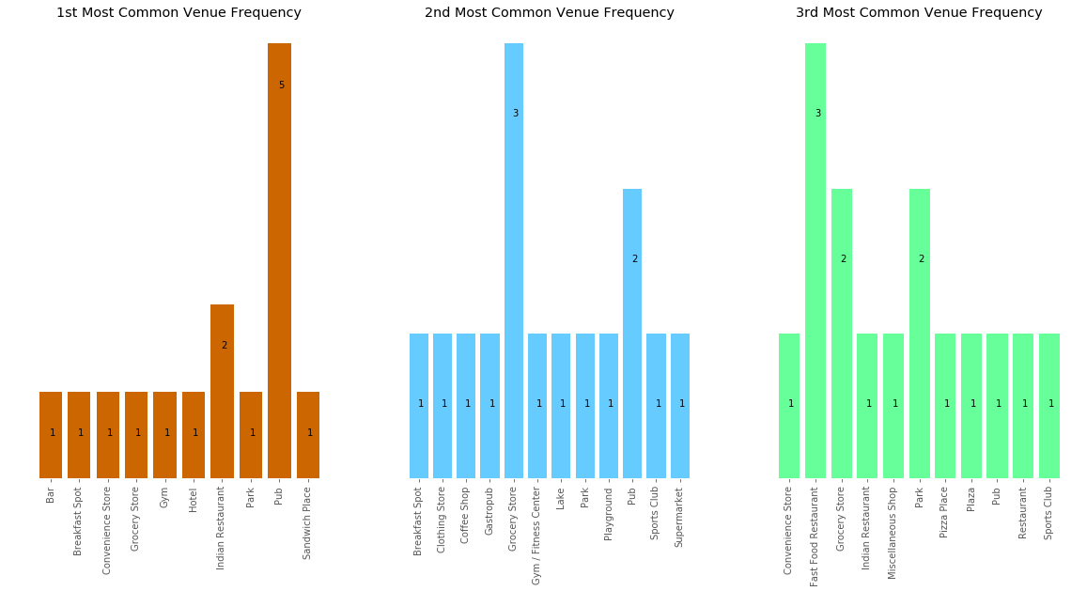
yellow Sector

Slide 9
Discussion
Purple clusters are mostly concentrated to urban areas with a high number of Pubs, Coffee shops and Hotels
Red clusters are mostly concentrated to suburban areas, with a high prevalence Grocery Stores, Indian Restaurants and Pubs
Yellow clusters are mostly concentrated to rural areas, with a prevalence of Pubs and Grocery Stores.

Slide 10
Conclusion
Low risk investments should include: Pubs, Coffee shops, Hotels, Grocery Stores and Indian Restaurants in Birmingham
Yellow cluster suitable for housing (many items of interest such as lakes, plazas and parks)
Demographics correlate with venues, high number of ethnic restaurants

